Slide 1
Using R Notebook
A Guide to Organizing and Presenting Data for an Aesthetic Delivery Using R Notebooks

Slide 2
Table of Contents
R Notebook..........................................................................................................3-12
GitHub Basics.....................................................................................................13-21
GitHub Desktop...............................................................................................22-2X
Credits.......................................................................................................................2X

Slide 3
R Notebook

Slide 4
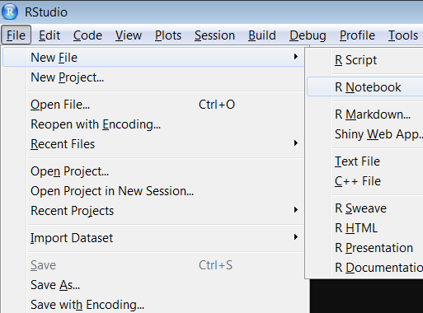
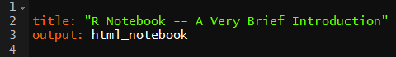
Initialization
When starting a new R Notebook file, select the “R Notebook” file type specifically from the dropdown menu
Alternatively, you can save any file you have open in RStudio as an R Notebook file by saving the file with the file format ending “.rmd”
Common Question: What is with the “--- title output ---” at the beginning of the file?
Answer: This notation allows you to edit the metadata associated with your document. We will go into what you need to know about them on the next slide.

Slide 5
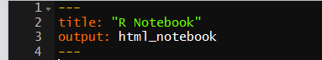
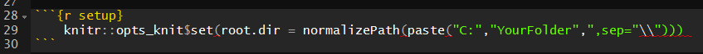
Initialization (Continued)
At the top of your new document, you will encounter the following:
If you’d like to change your working directory at any time in your document, then add the three lines of code at the bottom of this slide before you begin
Replace “YourFolder” with the folder that you would like to connect to
This is an example of a “Chunk”
More on why this step is necessary will be explained in a few slides
These are used to give a title to your document and to dictate your file output type, respectively

Slide 6
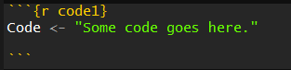
Chunks?
The main benefit of using R Notebooks to present data is the use of what are known as “chunks”
Chunks refer to areas within the document where interpretation of input switches from simple text to code
By default, the command “ctrl-alt-I” inserts a chunk into your document
Chunks can be given names
To name a chunk, replace the {r} at the beginning of the chunk with {r “name”}
Your chunk will now have the name “name”
A named chunk appears as follows:
R Notebook provides support for the following languages:
R
Bash
Python
Rcpp
SQL
Stan

Slide 7
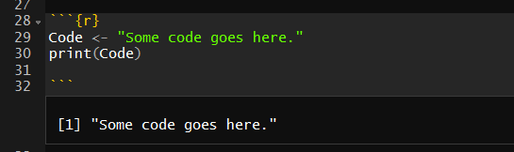
Executing Chunks – Inline
Chunks can essentially be “toggled on and off”, meaning you can either have them execute and display output in real time or not
By default, chunks are displayed “inline”, meaning that the resulting output of executing the code is displayed within the body of your document
Common Question: Is each chunk independent of one other, like how local variables within a function are not available within another function?
Answer: For the most part, no: generally, anything you define above a line in R Notebook is considered to be global, and you can refer to it in a later chunk. The exception to this is altering the working directory.
By default, R doesn’t want an R Notebook chunk messing with things outside of the file itself
Thus, R doesn’t permit chunk assignments to change the working directory any further than the end of the chunk
This can be bypassed however by replacing{r} with {r setup} and then executing the “knitr::opts_knit…” code previously shown.
While normal R Notebook files are presumed to be self-contained, the special name “setup” allows outside interactions to be done

Slide 8
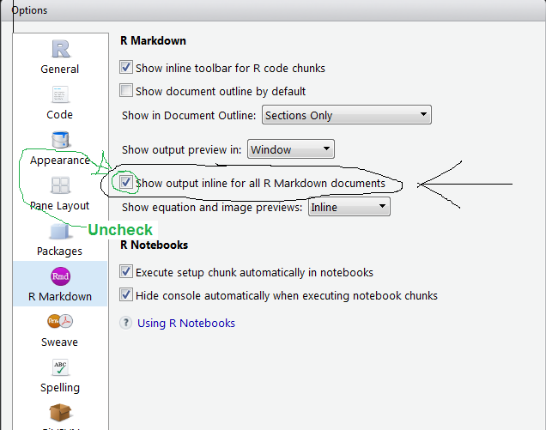
Executing Chunks – In Console
R Notebook also includes the option to present chunk output in the console
To access this, click Tools -> Global Options, then select ‘R Markdown’ 6th down from the left and uncheck the indicated option displayed to the right

Slide 9
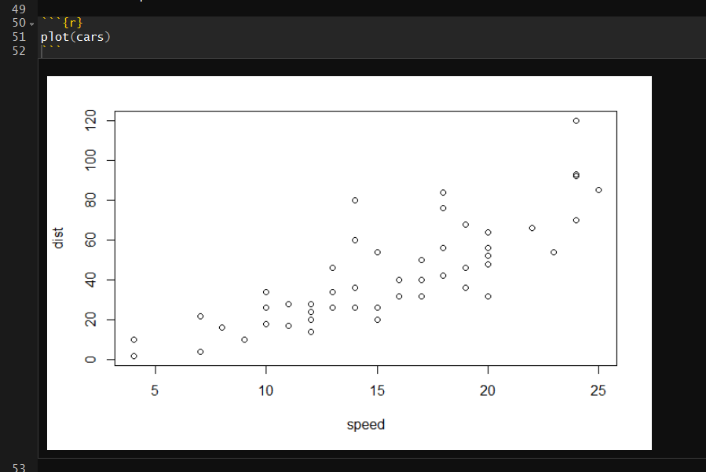
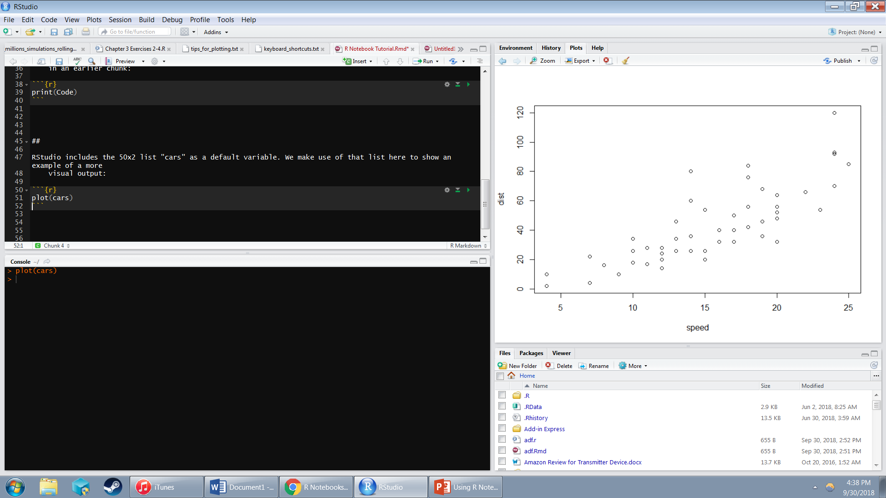
Comparison of “Inline” and “In Console” Output
Inline
In Console

Slide 10
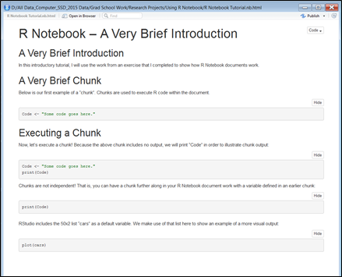
Previewing Output
An R Notebook document can be “previewed” as output, displaying data as a rendered R Markdown document without executing any of your chunks
However, all currently inline-displayed chunks that are showing will appear in the previewed document
The “preview” option is just to the left of the small gear icon displayed earlier
An example of output from an R Notebook document

Slide 11
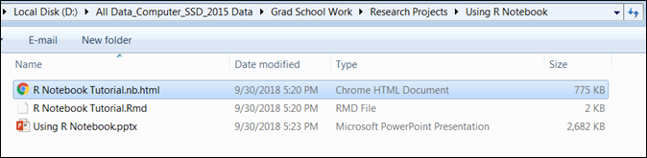
Saving and Additional Concerns
Whenever you save your document, alongside the .rmd file you are currently working on, a .nb.html file is created
This document is simply an html file displaying exactly what clicking “preview” would have done at the time of saving
File formatting within an R Notebook document is done in the markdown formatting language
Markdown is an easy-to-use text formatting language that allows for the creation of rich text using plain text
For more information on formatting using markdown, consult https://daringfireball.net/projects/markdown/basics
This document can be shared with others and opened either within a web browser or within RStudio itself

Slide 12
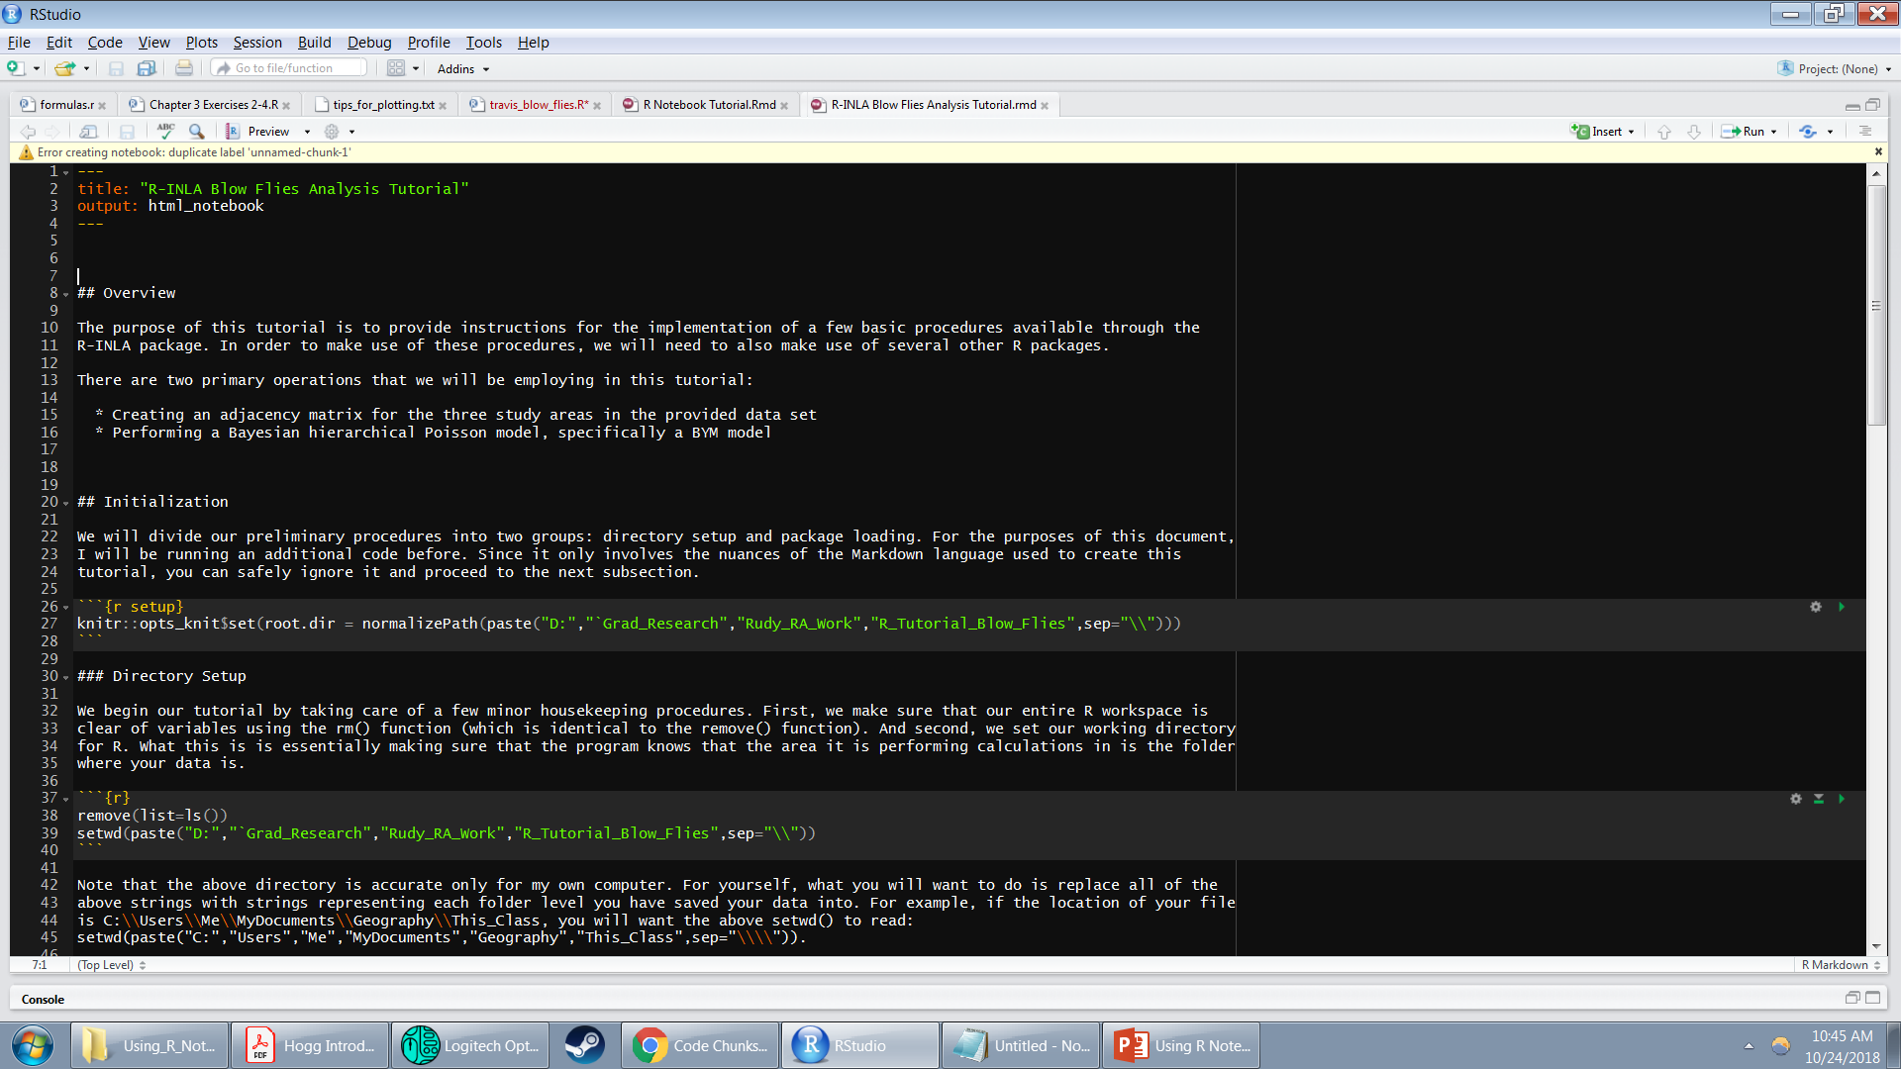
Common Errors
Error: 'is_latex_output' is not an exported object from 'namespace:knitr' Execution halted
Solution: Run the following code in your R console:
install.packages('knitr', repos = c('http://rforge.net', 'http://cran.rstudio.org'), type = 'source')
_
Solution: Give a unique name to all of your unnamed chunks

Slide 13
GitHub Basics

Slide 14
Version Control: Organizational Saving and History Tracking
Have you ever edited a document “doc” and then saved it as “doc_V2”? And then “doc_V3”?
This is called version control
Drawbacks:
Saving new edits quickly becomes tedious
You might accidentally save over old versions
Introducing Github: a website that streamlines the procedure of version control
Formatting in Github uses the markdown formatting language – the same as R Notebook!
In addition to keeping track of your document’s history, using Github for version control also offers the following benefits:
Creates an off-site copy of your document in the cloud
Allows for multiple “branches” of update history
Opens up ability to take a project down different paths synchronously
Maintains a sensible “direction” of edits two-dimensionally in a way that is not easily replicable by simply addending endings manually
Allows other users to collaborate and submit updated versions of your files

Slide 15
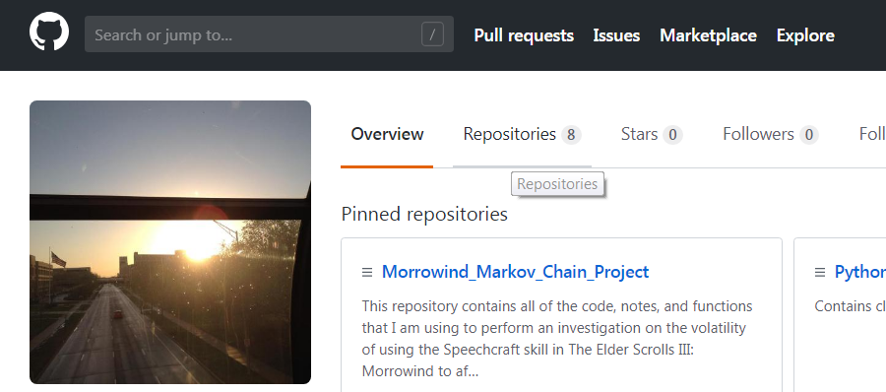
Github Tutorial – Getting Started
To start, go to http://github.com and create an account; Github will guide you through this process, but don’t worry, it’s straightforward
Now that you’ve got an account of your own, we can create a repository
Your homepage should look something like this:
Click on the “Repositories” tab adjacent to the “Overview” tab

Slide 16
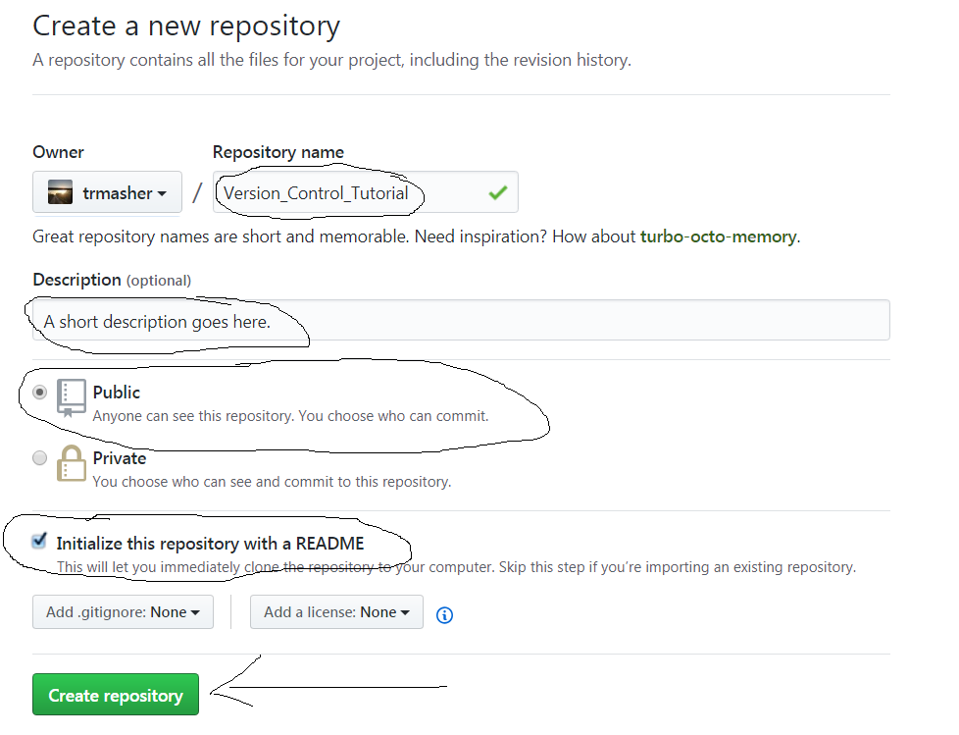
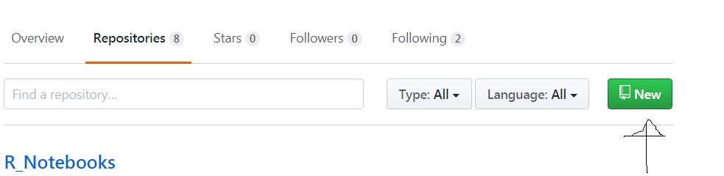
Github Tutorial – Creating Repositories
From here, click the green tab to the left that says “New”
Fill out or select the circled items to the right, and then click on the green “Create repository” button

Slide 17
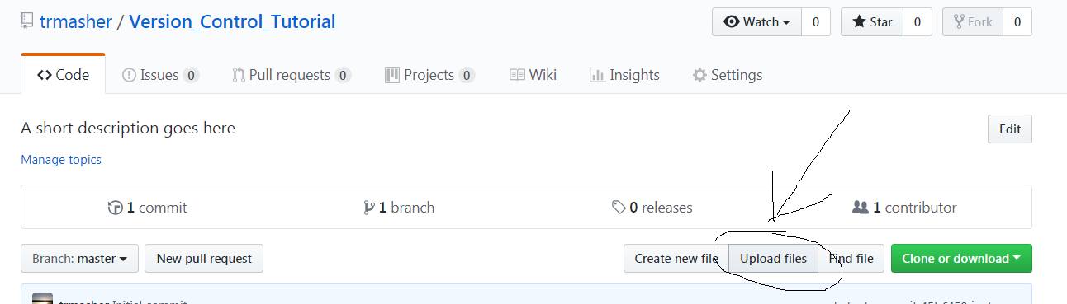
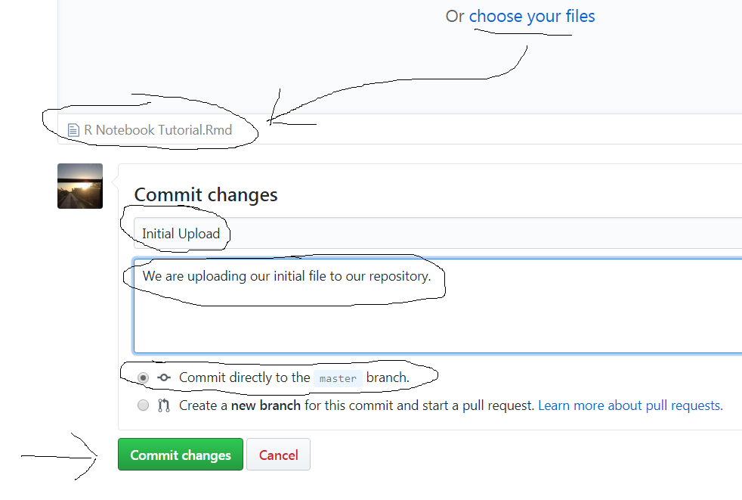
Github Tutorial – Uploading Our Document
Now that your repository is created, we want to upload our R Notebook document to it
→
On the next page, select “choose your files” in blue, then navigate your folders and double click your R Notebook file
Fill in or select the circled items to the left, and when you are done, click the green “Commit Changes” button indicated by the arrow
→

Slide 18
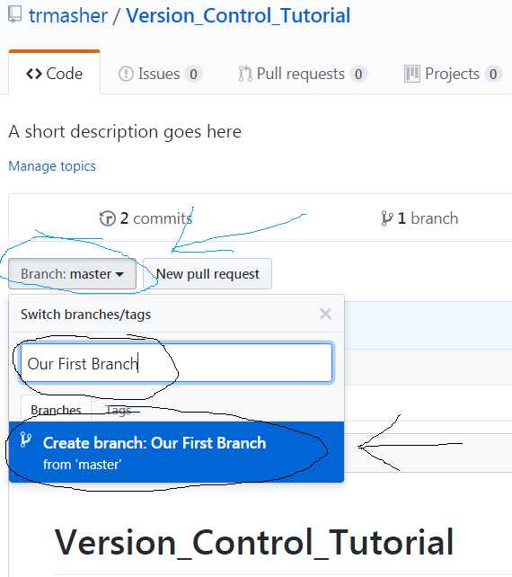

Github Tutorial – Branching Out
Our initial upload will now be referred to as our master branch; think of it to be as much of a “branch” as a tree trunk is to a tree
We will now create our first proper branch
First, click on the button that says “Branch: master” circled in blue in the picture to the right
Next, create a name for your branch in the dialogue box that opens
Now, click the button circled in black to the right to create the branch
We are now seemingly back to our previous screen, but note that this time all files we interact with are within the “Our-First-Branch” branch
We can toggle between branches and the master by selecting the button circle in blue as before and selecting “master” under the “Branches” tab that pops up

Slide 19
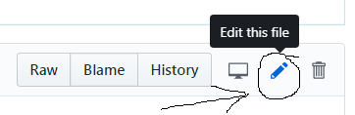
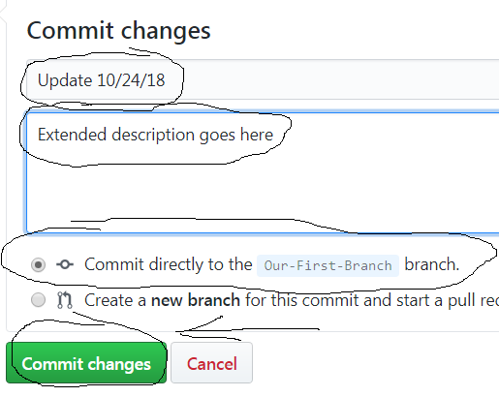
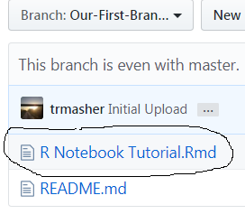
Github Tutorial – Editing Our Branch
We now wish to make a few changes to our branch
Click on this branch’s version of your uploaded file to open up a browser view of your document
Click on the pencil option on the right side of your screen (circled below) to begin editing
→
→
Make your editing changes, fill out the dialogue boxes circled to the left, and click the green “Commit changes” button at the bottom
→

Slide 20
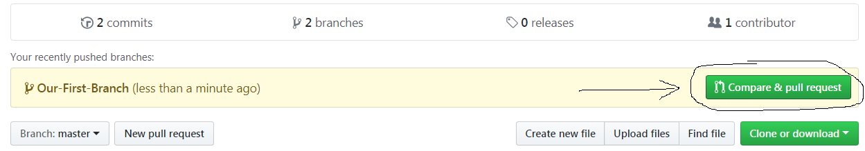
Github Tutorial – Pull Requests
Return to your repository’s page; you are greeted by a new tan box with our new branches name
The branch edit you’ve just made is said to have been “pushed”
We now wish to compare our branch edits to the master branch and then submit a pull request; to do this, click the green button below saying to do just that
On the screen that now appears, you will see the edit title and description that you created for the branch earlier
We will now create a pull request from our branch edits onto our master
A pull request from branch Z to higher branch A allows for the author of A to accept the edits to A by the author of Z
The author of A may either accept or decline
If you are the author of both branches, this is essentially asking you “Are you sure about this?”

Slide 21
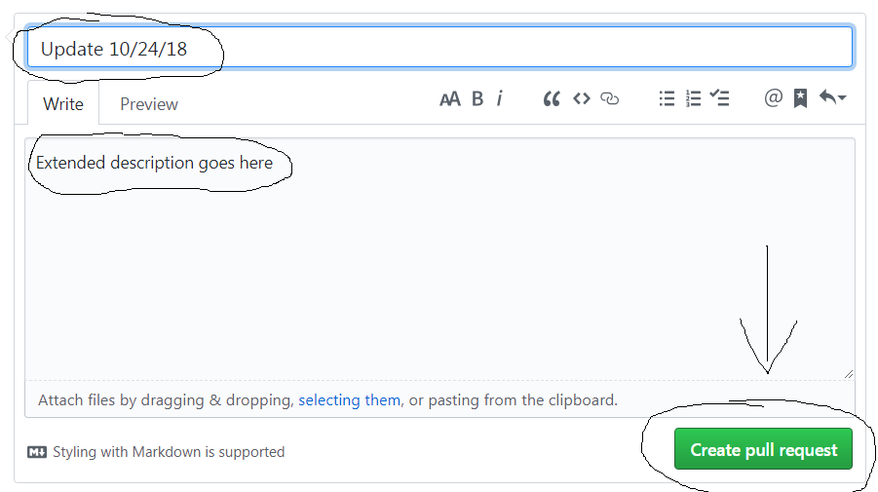
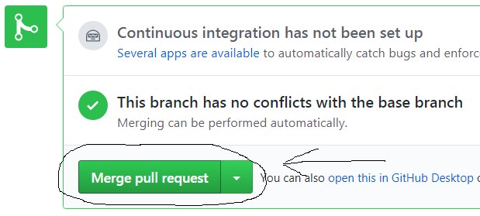
Github Tutorial – Merging Master and Branch
Click the green “Create pull request” button to the bottom right of your description box
You are now taken to a screen describing various things about the pull requested branch’s edit to your master branch
If you accept the edits that you have made, select the green “Merge pull request” button and then the green “Confirm merge” button that pops up right after
One final note: any of the languages R Notebook supports can be uploaded to Github in the exact same way as described in this presentation
→
→

Slide 22
GitHub Desktop

Slide 23
Installing GitHub Desktop

Slide 24
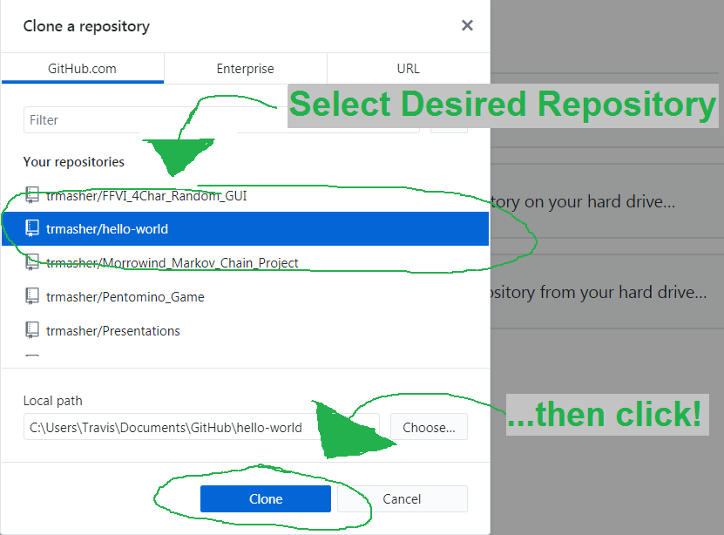
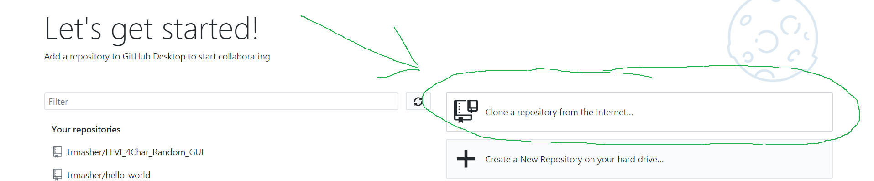
Retrieving our First Repository
After signing in, you are greeted with an initialization menu
Select the “Clone a repository from the Internet…” option (shown below)
→
On the window that appears, select the repository you wish to clone by highlighting it and then push the “Clone” button (shown right)
This will create an identical copy of all files within the repository
Repository folders will be stored under the path “C:\Users\YourAccountName\Documents\GitHub”
→

Slide 25
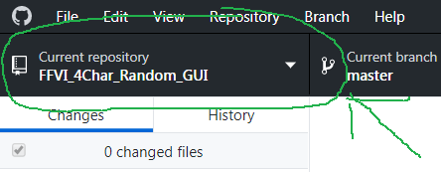
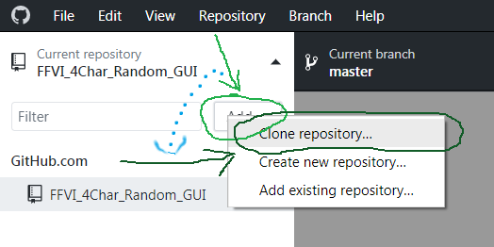
Retrieving Additional Repositories
To clone additional repositories to your desktop, select the box displaying the current local repository (shown right)
A box displaying all current cloned (local) repositories appears
→
Click the “Add” button (shown in light green)
Select “Clone repository…” (shown in dark green) to open a familiar window
Navigate this window identically to the previous slide to select your repository
→
----------------
→
→

Slide 26
Creating New Branches

Slide 27
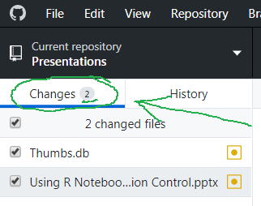

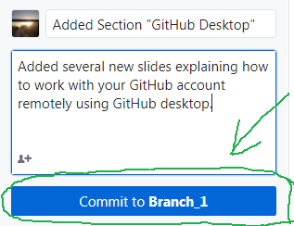
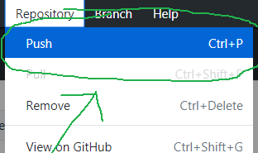
Uploading Local Edits – Using “Push”
After making changes to cloned documents locally, GitHub desktop will indicate the number of changed files and display them below
To commit these changes to your current branch, fill out the sections directly below your list of changes and click the “Commit to YourBranch” button
We now want to upload our changes to our GitHub account
Select the “Repository” heading from the top navigation panel
→
→
Select the “Repository” heading from the top navigation panel
→
→

Slide 28
Credits
This informational presentation was compiled using the helpful guides available on the rmarkdown website as a general guide
https://rmarkdown.rstudio.com/r_notebooks
https://guides.github.com/activities/hello-world/
Ancillary information about R Markdown concepts gathered from the following specific webpages:
https://rmarkdown.rstudio.com/lesson-1.html
https://bookdown.org/yihui/rmarkdown/html-document.html
https://rmarkdown.rstudio.com/articles_intro.html
https://en.wikipedia.org/wiki/Markdown

